Slide 1
Android TV
Thomas Belk
Notes:
My name is Thomas Belk
Graduated from the University of Delaware with a degree in Computer Science
Started working on Android back in June 2010 with ING Direct
Moved over to Vanguard, worked there for a few years as an Android Developer
Started my journey at Capital One this past June as an Android Developer
Android is my hobby and my profession
In this presentation I’ll be going over Android TV, the essentials for Android TV development
Side Note: the game included in this is a bit messy but I can talk about it after this core of this presentation is over

Slide 2
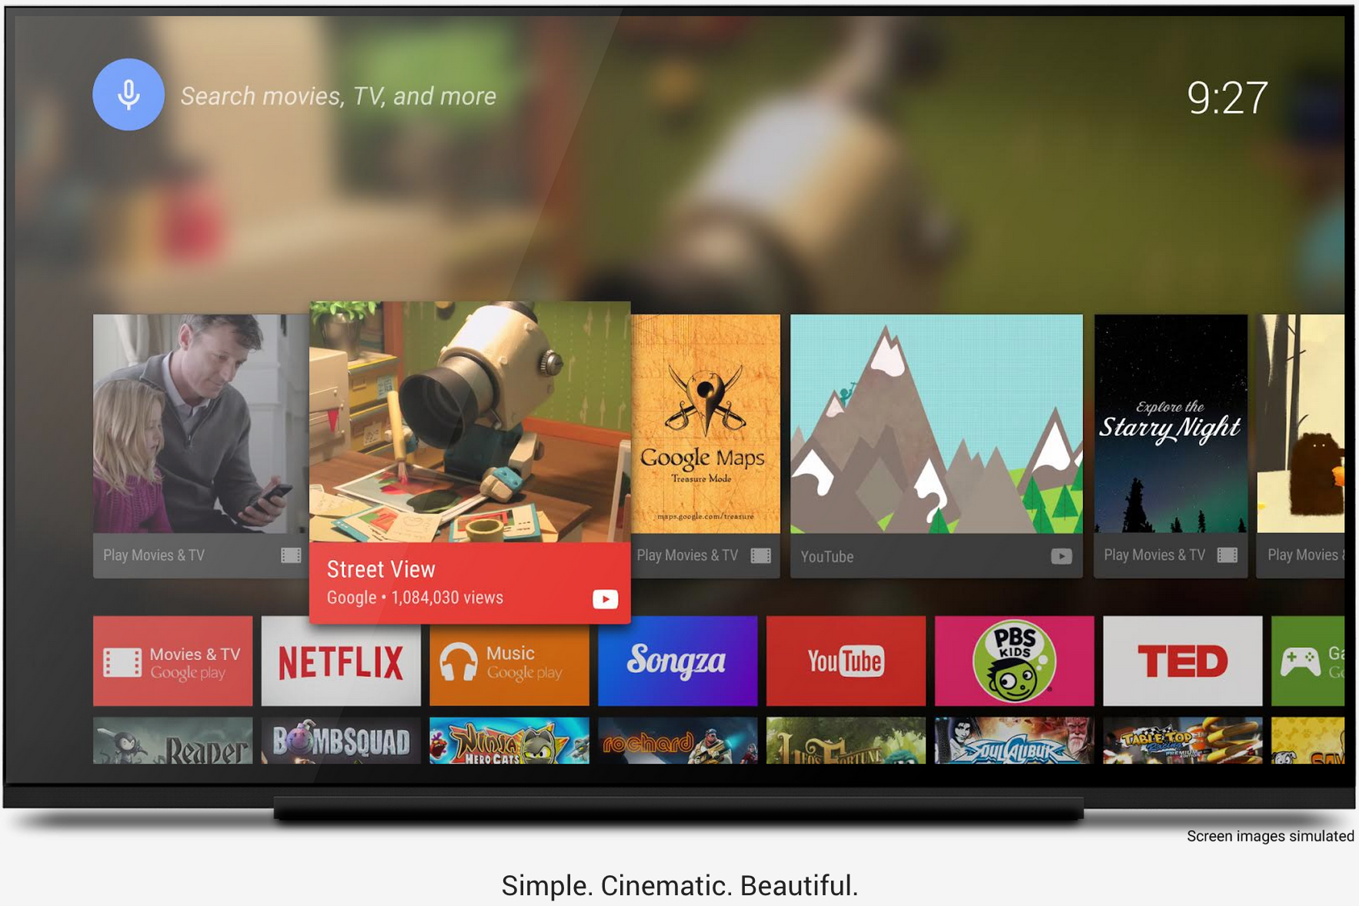
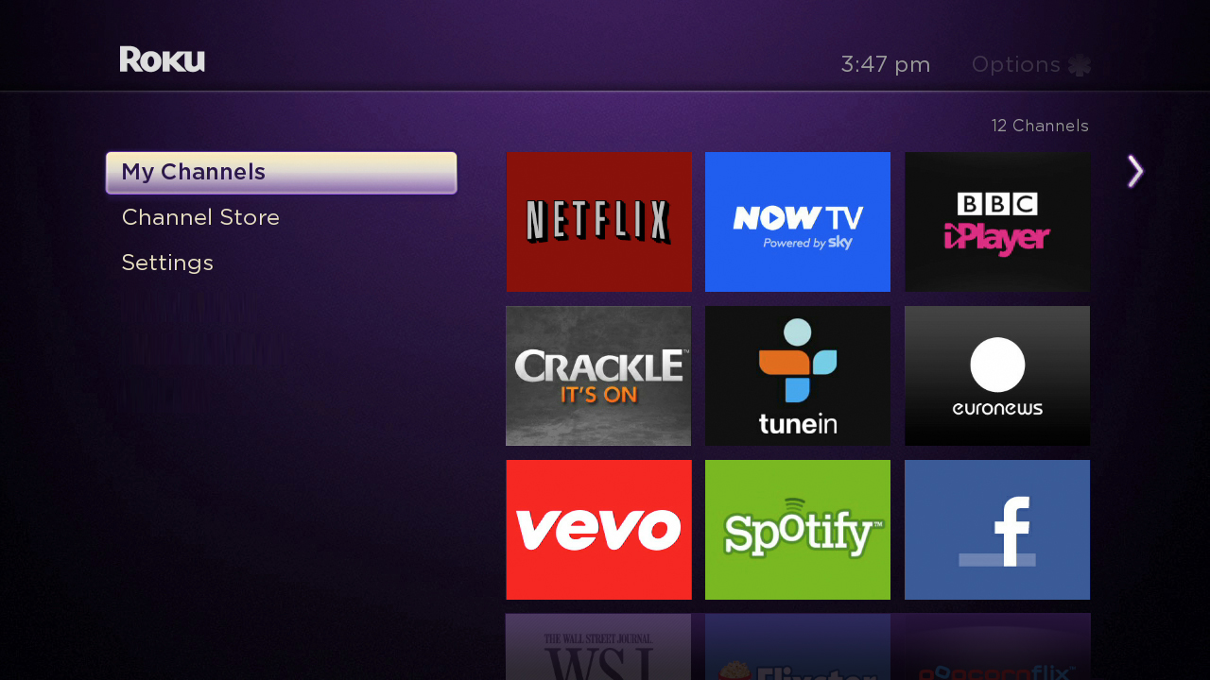
Overview
"Android TV is Android, optimized for the living room consumption experience on a TV screen"
Notes:
This is a quote directly from Google
Android TV is exactly that, its Android that uses a new support library for enhanced user views with more cinematic experiences.
Interactions are fluid, intuitive and fast
Very similar to what some entertainment apps already use on mobile phones, such as Netflix & Roku. You can see in the picture the ‘ribbon’ type view, similar to Netflix & Roku, Android TV makes heavy use of. As an example you can see the image on the right is from a Roku user interface.

Slide 3

About
Runs Android 5.0
Announced on June 25, 2014, at Google I/O
Supports Google Cast
Removed packages with functionality for:
making/receiving calls
the camera
near-field communication
Partnering with manufactures to bundle the slimmed OS in TVs
Notes:
Runs Android 5.0, Lollipop
Announced at Google I/O
Supports Google Cast, which is the technology behind the Chromecast media player
The verge reported that Google has removed touchscreen support, but I’m not sure if that’s true as some ‘TV’s’, likely monitors, can still provide touch screen interactions.
Google is partnering with a few TV manufactures to package the slimmed lollipop OS in TVs coming 2015

Slide 4
Specifications
ADT-1
Trega 4/Trega K1
2GB of RAM
16GB of storage
Bluetooth 4.0
HDMI
Wifi ready
USB port
Nexus Player
Intel Atom
1GB of RAM
8GB of storage
Bluetooth 4.1
HDMI
Wifi Ready
USB port
Notes:
Announced at Google I/O. Shortly after developers could register for a lottery in which they could receive the ADT-1 early version of the device
The ADT-1 was the early version of the device, it features those specs. It’s worth noting that some got the Trega 4 chip while others have the K1. The Trega 4 is a 1.8GHz quad core while the K1 is a 2.2GHz quad core.
The first consumer market ready Android TV device is the Nexus Player. It’s worth noting it has less RAM, less storage, but a slightly faster processor although the clock speed wouldn’t suggest it; 1.8GHz quad core.

Slide 5
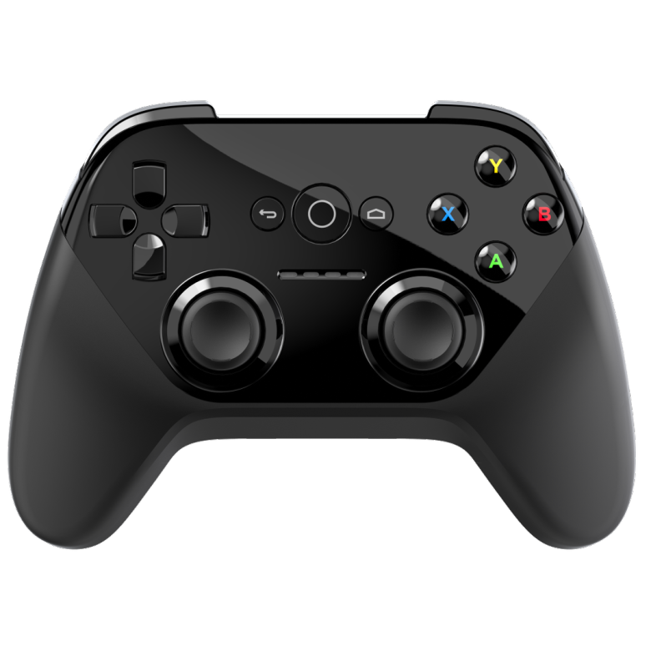

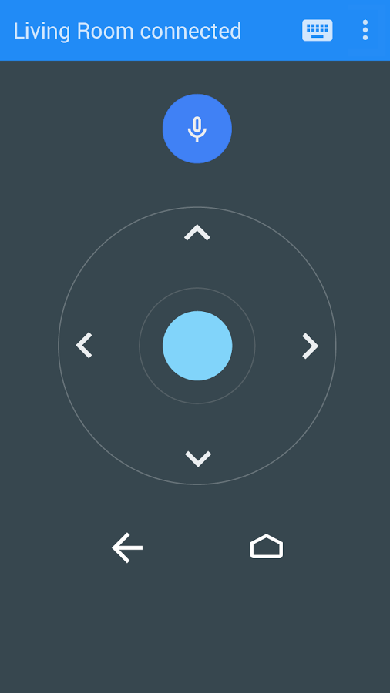

Controllers
Gamepad Controller
Remote
Notes:
There are two general types of controllers, one is the game pad controller which I’ll discuss more about later and the other is the remote, which gets packaged with the TV if you buy it from the Google play store now.
There’s a sudo 2.5 controller which is your phone. By downloading the Google build app called ‘Android TV Remote Control’ you get the same functionality of the remote on you phone.
This remote control app will pair with your device, just like a device that detects a chromecast. You will then need to enter a 4 digit pin code. Interaction with the TV’s interfaces is pretty simple beyond that point.

Slide 6
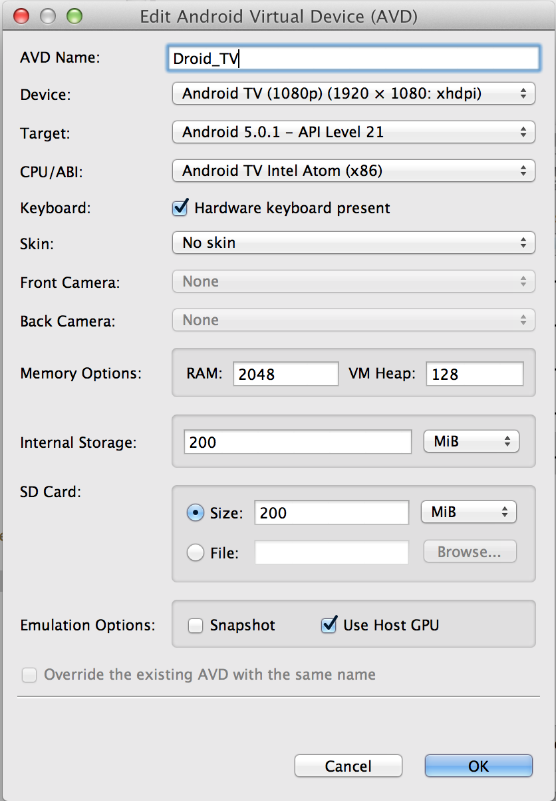
Emulator Setup
Notes:
This is my emulator instance and its configurations. You can see that I’m using the Android TV Intel Atom CPU, that’s because the emulator runs faster with it due to HAXM being installed.
There are configurations for 720p instances so if you’re concerned about not being able to display the whole emulator or it consuming too much space, perhaps even system resources, I would go with that.

Slide 7
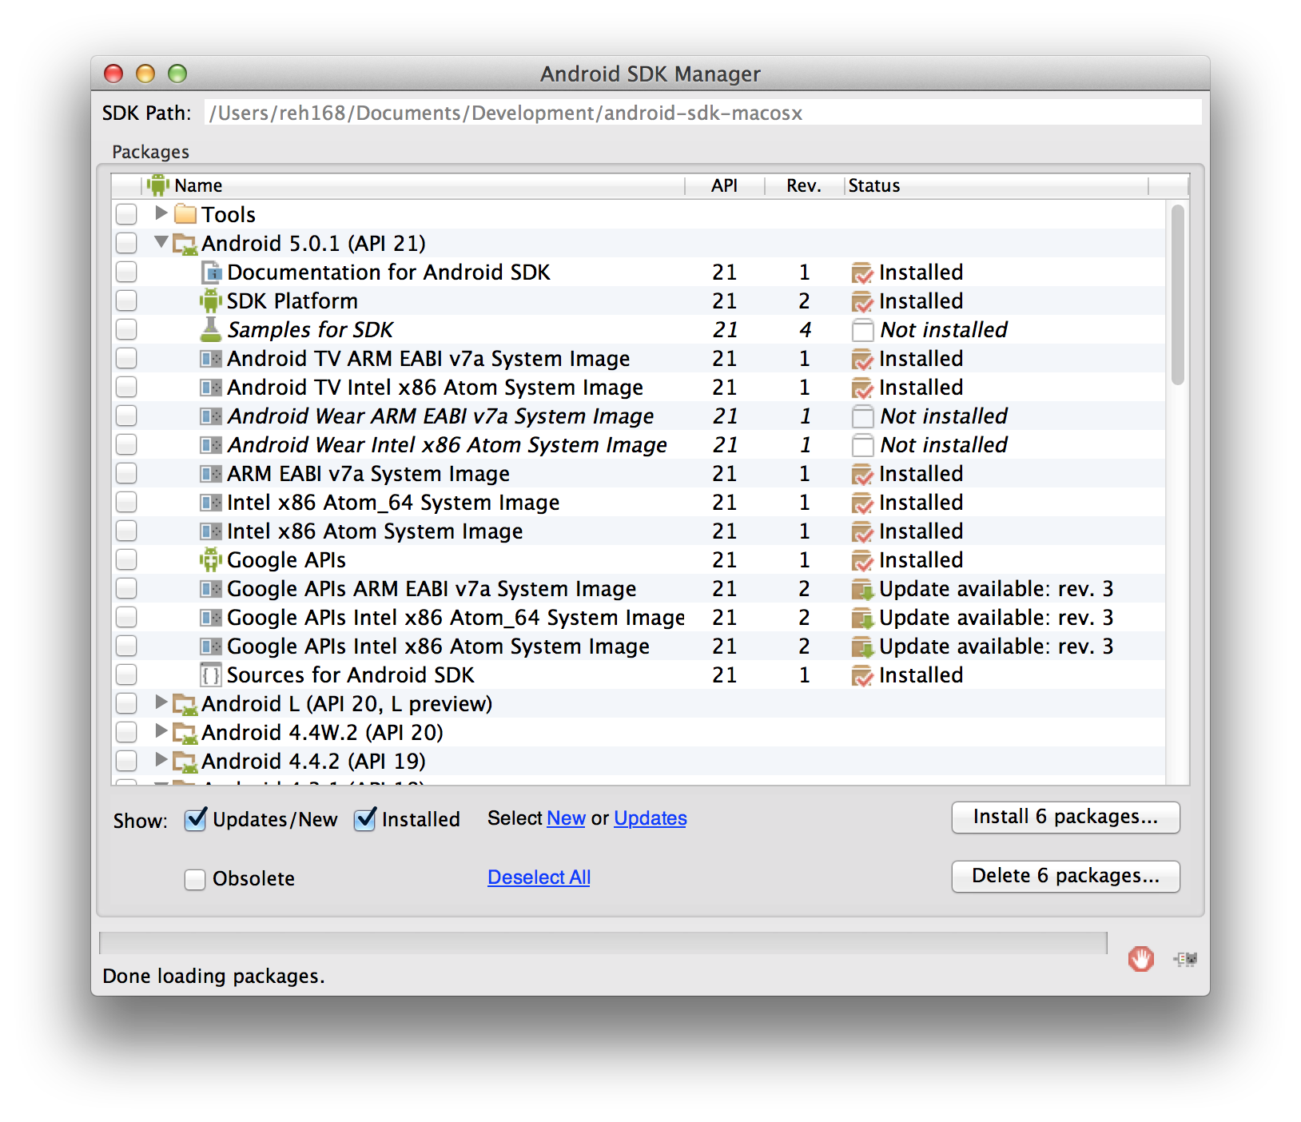
SDK Setup
Recommended SDK Installs:
Android TV ARM / Intel System Image
SDK Platform (API 21)
Android Support Library
(Optional) Intel x86 Emulator Accelerator (HAXM)
Notes:
This of course assumes you already have a pre-existing Android Development enabled IDE
From your Android SDK Manager I would recommend installing:
Android TV ARM / Intel System Image
SDK Platform (API 21)
Android Support Library
(If not already installed) Intel x86 Emulator Accelerator (HAXM)
I personally would avoid the L Preview anyting (API 20). It’s not necessary to get an up and running Android TV project.

Slide 8
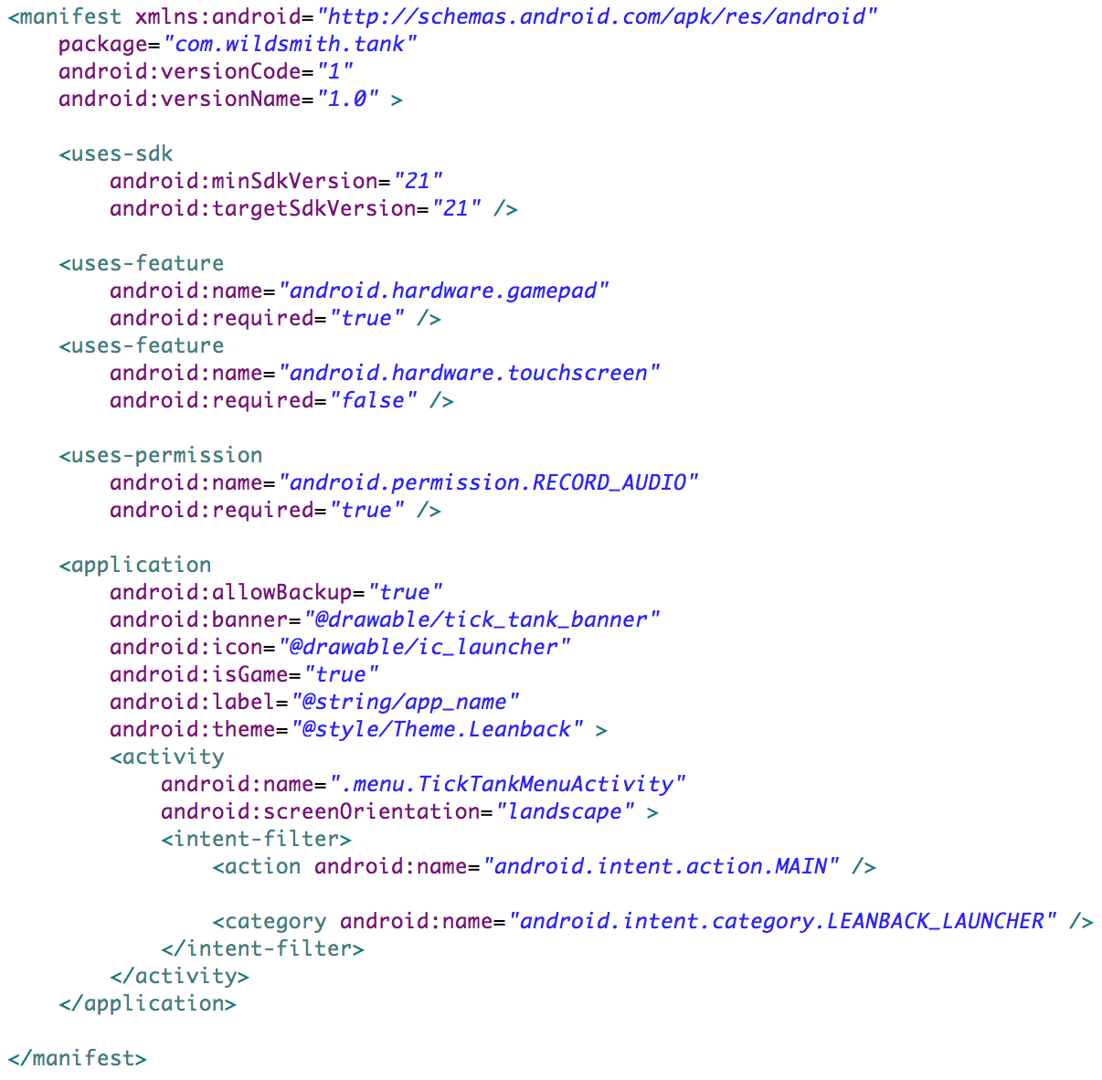
New Project
Android Manifest
Min/Target SDK: must point to version 21 (at this point there isn’t anything higher)
Theme: must be some extension of the Theme.Leanback if you want to use leanback widgets
Launcher: The Activity you wish to launch into must have a intent filter category of LEANBACK_LAUNCHER
Supported Hardware: If you’re requiring any specific hardware, such as gamepad or touchscreen, call it out
Notes:
Once all the necessary SDK installs have been made and an emulator instance has been created we can setup the new project.
Side Note regarding your IDE. Based on which one your using you might have the option to create a new Android TV project, I believe Android Studio offers this, you can use that if you want. I’m still using Eclipse only because at the time I started this project Android Studio was still in Beta.
Most Android TV projects require at least this in their AndroidManifest. The only option field is the RECORD_AUDIO permission that is necessary if you want to implement a search feature within your application.

Slide 9
New Project
Android Manifest
Application Category: the home screen categories games in a separate row so call out that this is a game to get your application grouped correctly (android:isGame=“true”)
Application Banner: the home screen displays applications using their banners, no longer their icons (android:banner=“@drawable/…”)
Notes:
Banners: must be 320 x 180 px in the xhdpi resource folder of your application
Text should be included in the image. If your app is available in more than one language, you must provide versions of the banner image for each supported language.
There’s a whole slue of UI Pattern definitions provided by Google it can be found here: https://developer.android.com/design/tv/patterns.html

Slide 10
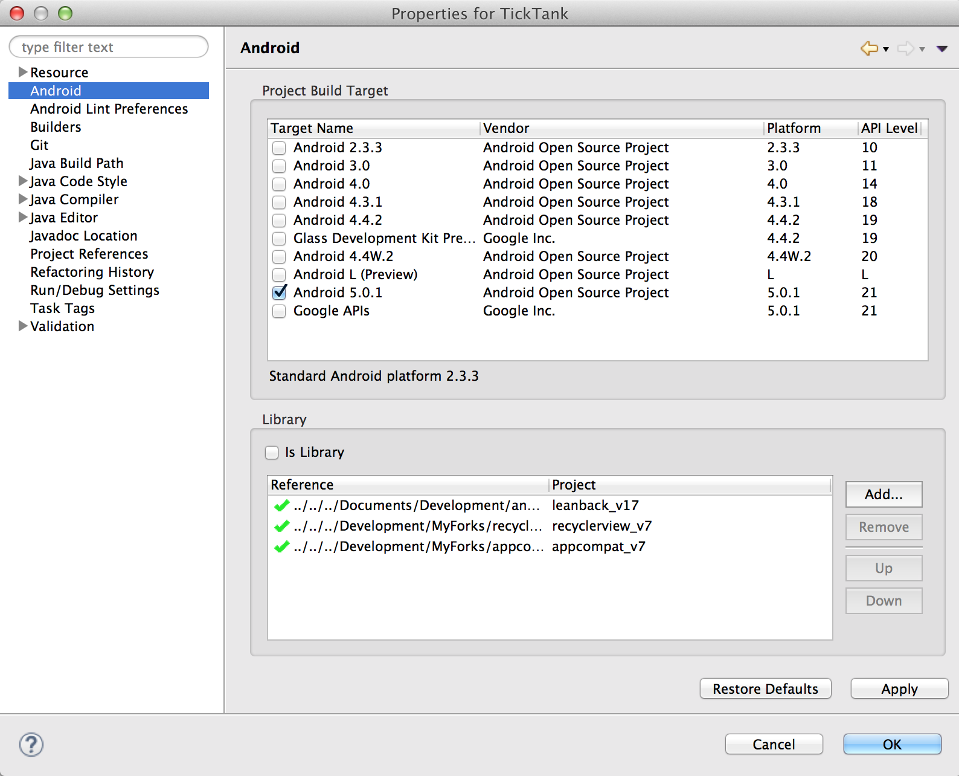
New Project
Target Name: Android 5.0.1
Project Dependencies:
leanback_v17
recyclerview_v7
appcompat_v7
Notes:
If you wish to use the leanback library you’ll also need to have project dependencies on recyclerview and appcompat. This wasn’t outline by Google on any o their developer pages. Sadly I think one library has a dependency on another but was somehow build without it. Hence if you need one you’ll need all three.

Slide 11
Leanback : Do the rockaway
“This song is all about Terror Squad being too cool to dance” – genius.com
“Lyrical genius of our generation” – somebody
“Modern day Beethoven” – another person
Came out in 2004 by the Terror Squad
Questionable lyrics
Popular when I was in high school
Form your own opinions
Notes:
enough said…

Slide 12
Leanback Library
Provides new APIs and widgets to support building user interfaces on TV devices. Including:
BrowseFragment
DetailsFragment
PlaybackOverlayFragment
SearchFragment
Notes:
Leanback library was created to provide support and helpful widgets when creating Android TV applications
BrowseFragment - A fragment for creating a primary layout for browsing categories and rows of media items.
DetailsFragment - A wrapper fragment for Leanback details screens.
PlaybackOverlayFragment - A subclass of DetailsFragment for displaying playback controls and related content. I won’t be covering this with my project.
SearchFragment - A fragment to handle searches. The fragment receives the user's search request and passes it to the application-provided SearchResultProvider. The SearchResultProvider returns the search results to theSearchFragment, which renders them into a RowsFragment.

Slide 13
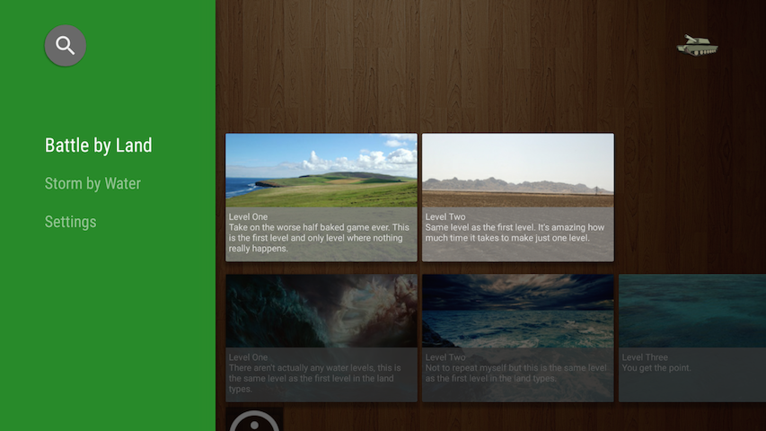
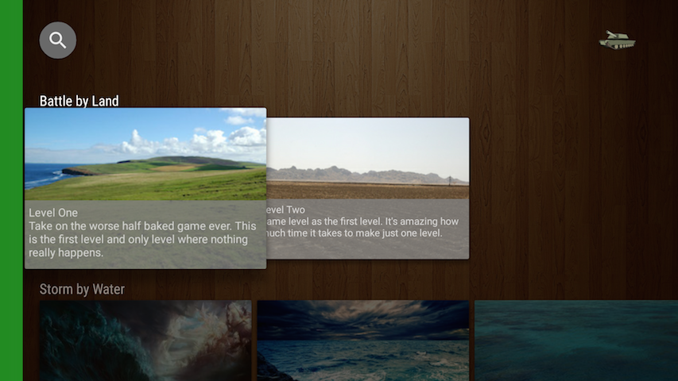
BrowseFragment
Notes:
BrowseFragment - A fragment for creating a primary layout for browsing categories and rows of media items.
I like to think of this as the menu of your TV application.
On the left side of the screen is a listing of categories, on the right the list of selectable items within the highlighted category
When you navigate to the right from the list of categories, the category drawer collapses to reveal a focus on your selectable items

Slide 14
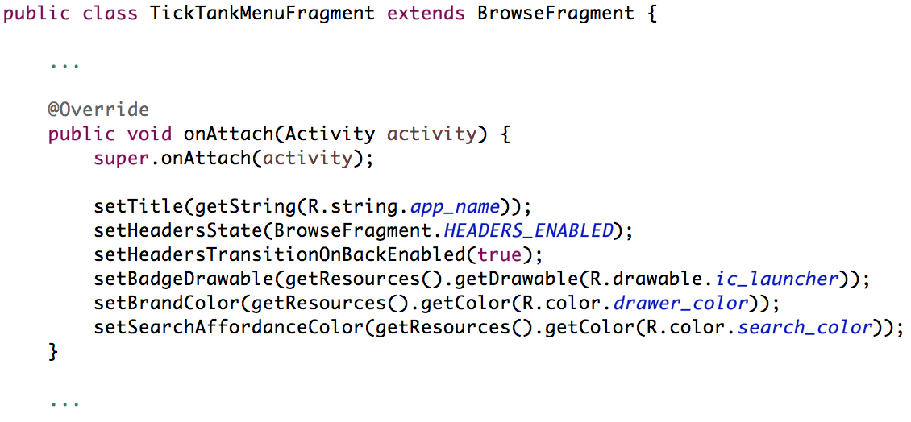
BrowseFragment
Extend BrowseFragment, calling any necessary UI convenience methods
Notes:
There isn’t a decent amount of coding that goes into extending and customizing the BrowseFragment
Steps:
Extend BrowseFragment
Use the ‘necessary’ convenience methods provided by new fragment, such as the brand color, search icon color, allowing headers (categories)

Slide 15
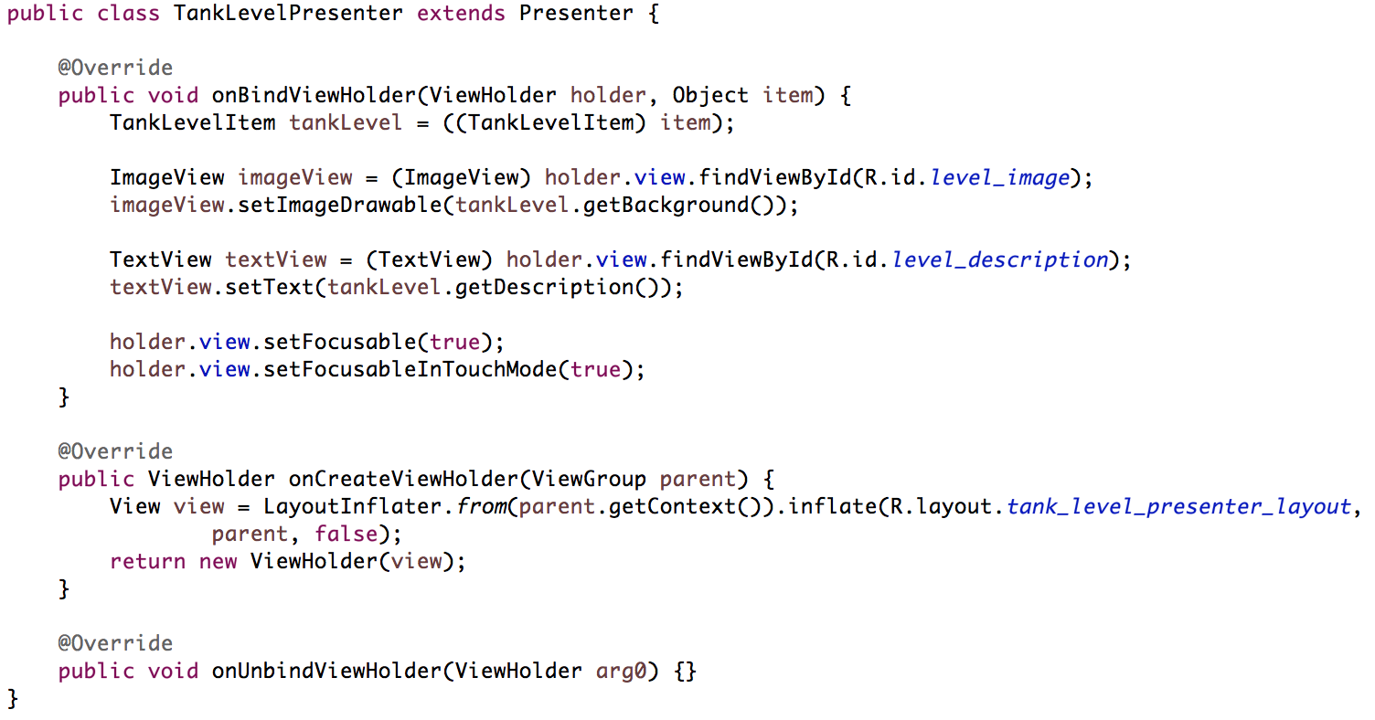
BrowseFragment
Extend Presenter
Notes:
BrowseFragment uses a presenter/adapter pattern to display information. The presenter structure is a mix between view holder for recycler views and recycler view adapters. I say this because the presenter is responsible for both inflating its view, holding the view, and finally populating it but is NOT the adapter for the list.
Create a Presenter for your information.
TankLevelItem is a POJO (Plain Old Java Object) with two fields. One is a String and the other a Drawable.
Note: if you don’t set your view to focusable the user will not be able to select it

Slide 16
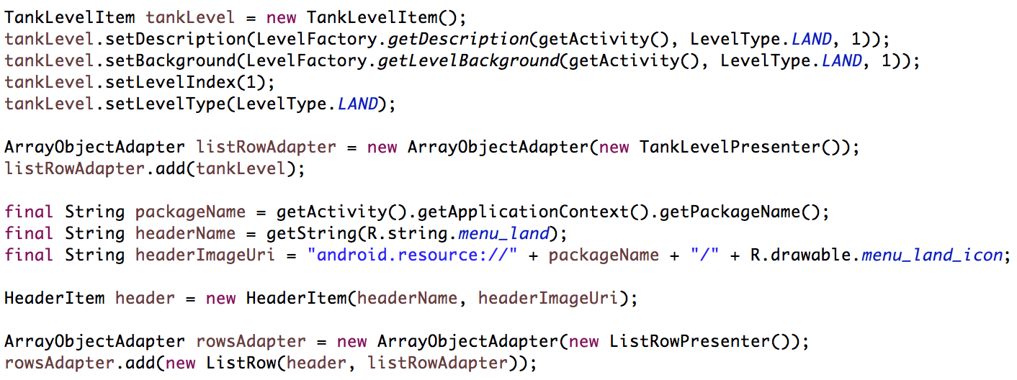
BrowseFragment
Populate the adapters
Notes:
We want to take the TankLevelItem POJO, set its attributes which will help customize the view, and add it to the adapter we’ve instantiated using our TankLevelPresenter.
The next step is creating a HeaderItem for the row. A HeaderItem is the category the selectable tank level is associated with.
It is important to note, you are able to set the image of the header row unfortunately there is a known bug with setting the resource uri of the image in the header item and the image not appearing
Finally we want to create a new list row with the header and our adapter. This list row will then get encapsulated into yet another adapter responsible for cycling threw rows in the list.
The reason we need two adapters is because one adapter will handle scrolling horizontally, while the other handles scrolling vertically.

Slide 17
BrowseFragment
Notes:
This slide is ugly because its so important you need to notice it and remember it.
You must call setAdapter in the BrowseFragment, passing in the adapter we’ve just created. If you don’t do this, nothing will show up!

Slide 18
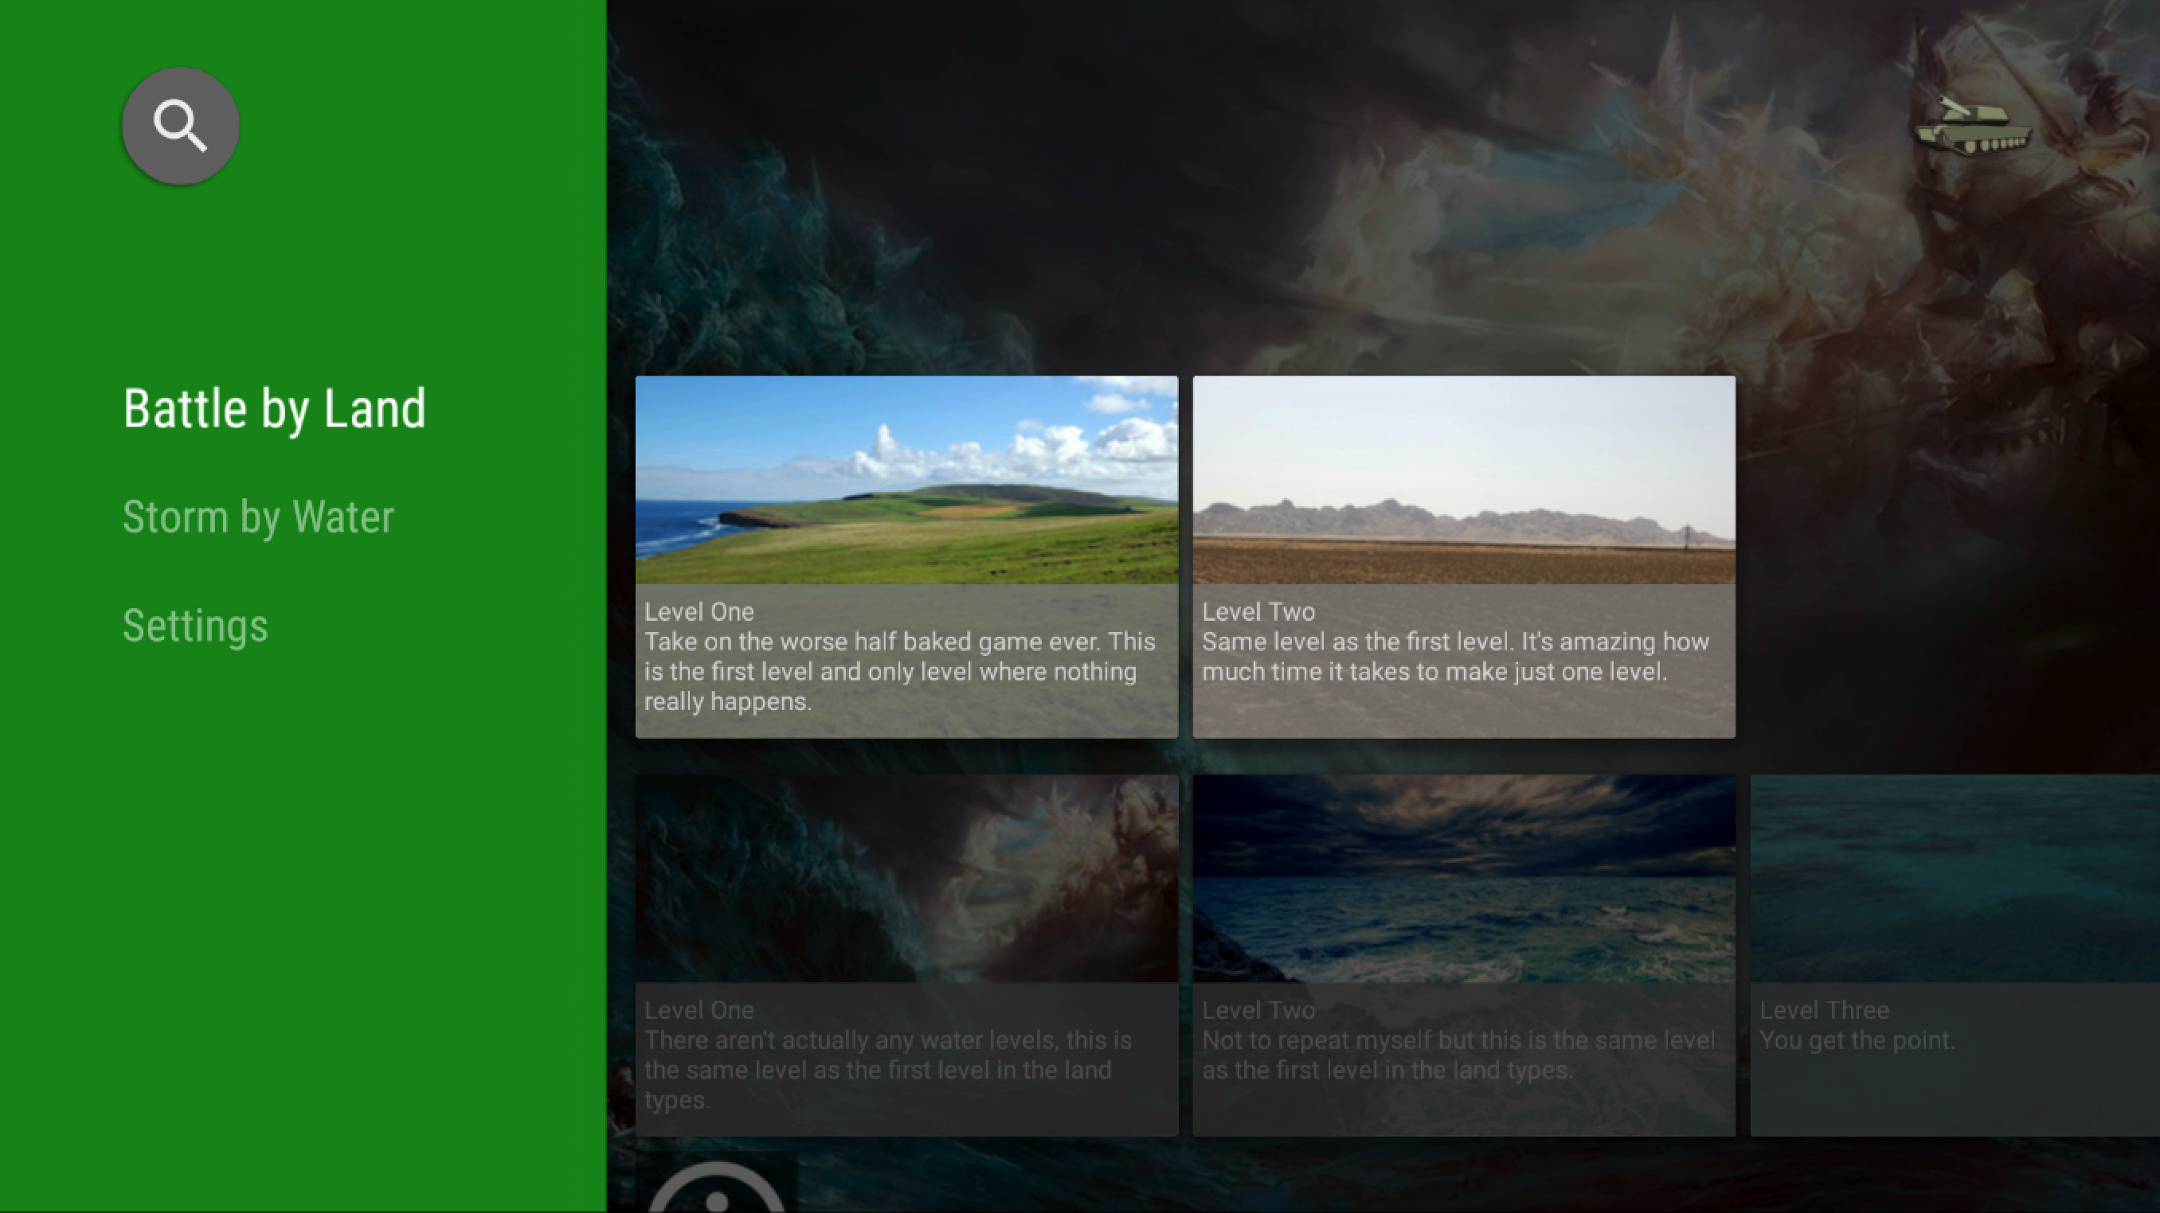
BrowseFragment
Notes:
- Video of browse fragment navigation

Slide 19
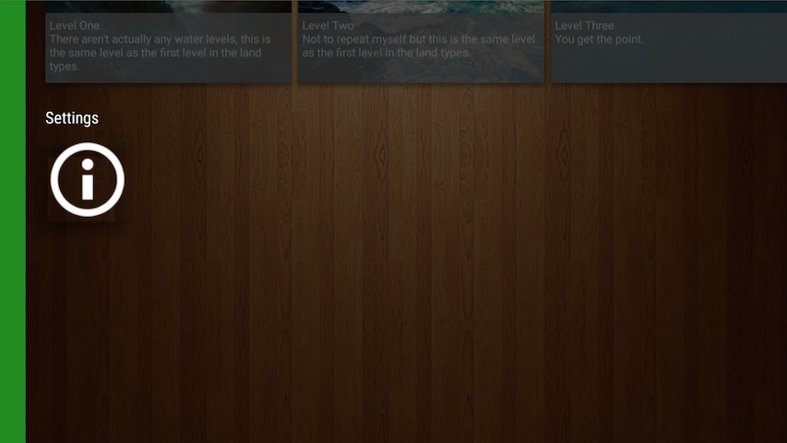
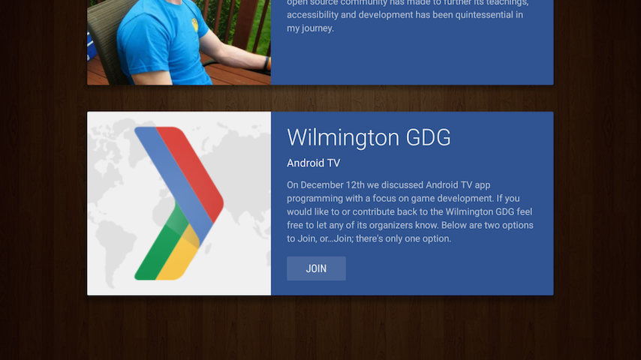
DetailsFragment
Notes:
DetailsFragment - A wrapper fragment for Leanback details screens.
I like to think of this as the purchase merchandise menu of your TV application.
The name of this view is self explanatory, it lists more information about the item selected on the previous screen
Each details panel has the option to add Actions. These actions can be anything, calls to the back end, ways to launch new views, etc.

Slide 20
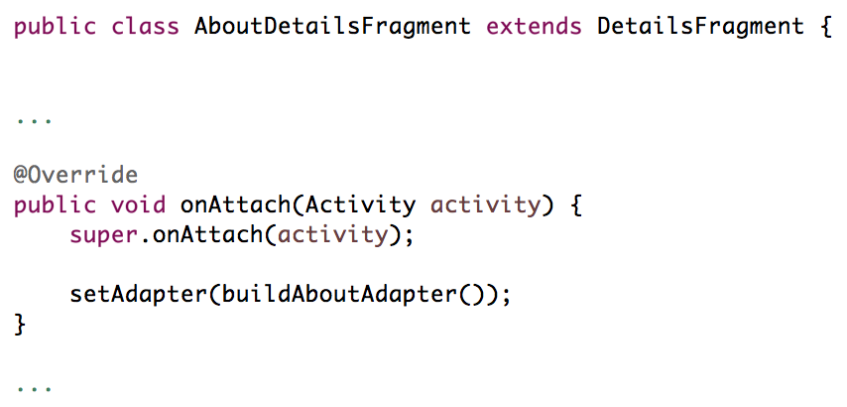
DetailsFragment
Extend DetailsFragment, setting the fragments adapter
Notes:
There’s much less to the view because there’s much less to this view; no header items to worry about, no brand color, etc.
You can however allow the view transitions to occur between opening and closing the fragments; although this isn’t new with details fragment but new with Lollipop.

Slide 21
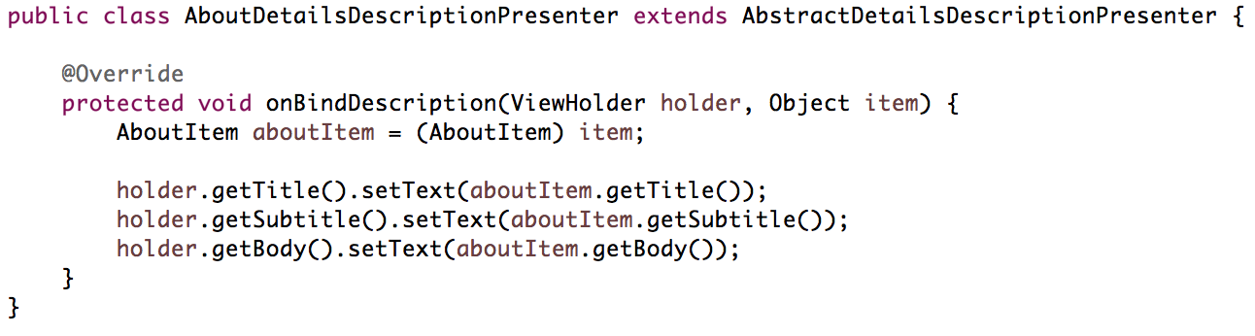
DetailsFragment
Extend Presenter
Notes:
Just like with the BrowseFragment we want to create an extension of the relevant presenter. In this case the presenter is AbstractDetailsDescriptionPresenter.
Unlike the Presenter used for the BrowseFragment this presenter only has one event, onBindDescription which passes in its own specific instance of ViewHolder. So there isn’t much wiggle room in terms of flexibility, but it is a free widget so oh well.
We’ll then populate that view holder with our three fields from the AboutItem POJO

Slide 22
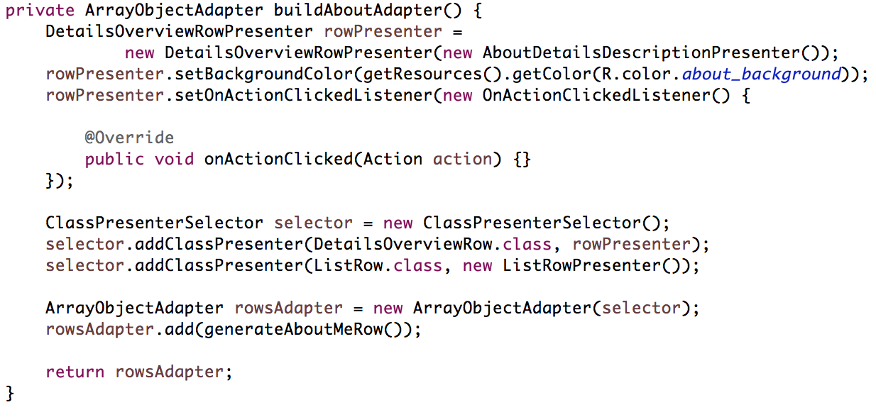
DetailsFragment
Populate the adapters
Notes:
Declare an instance of the DetailsOverviewRowPresenter and pass it our instance of the AbstractDetailsDescriptionPresenter. Here we can set the background and add as many actions as we want that do whatever we want.
Declare an instance of the ClassPresenterSelector; this is the first time I’ve mentioned this. This creates a sudo category type navigation without having the floating header or category. We add the instance of row presenter to it as well as an instance of ListRowPresenter. This official documentation says: ‘’ A ClassPresenterSelector selects a Presenter based on the item's Java class.” So when we add the rowPresenter we’re mapping it to the DetailsOverviewRow class. Meaning when that class is needed by the presenter selector it uses that instance.
Finally we add the selector to the presenter selector to on instance of the adapter. The difference between the DetailsFragment and BrowseFragment is that the browse fragment had two adapters, one for veritcal scrolling and another for horizontal scrolling, this view only scrolls vertically so there’s only one adapter necessary.

Slide 23
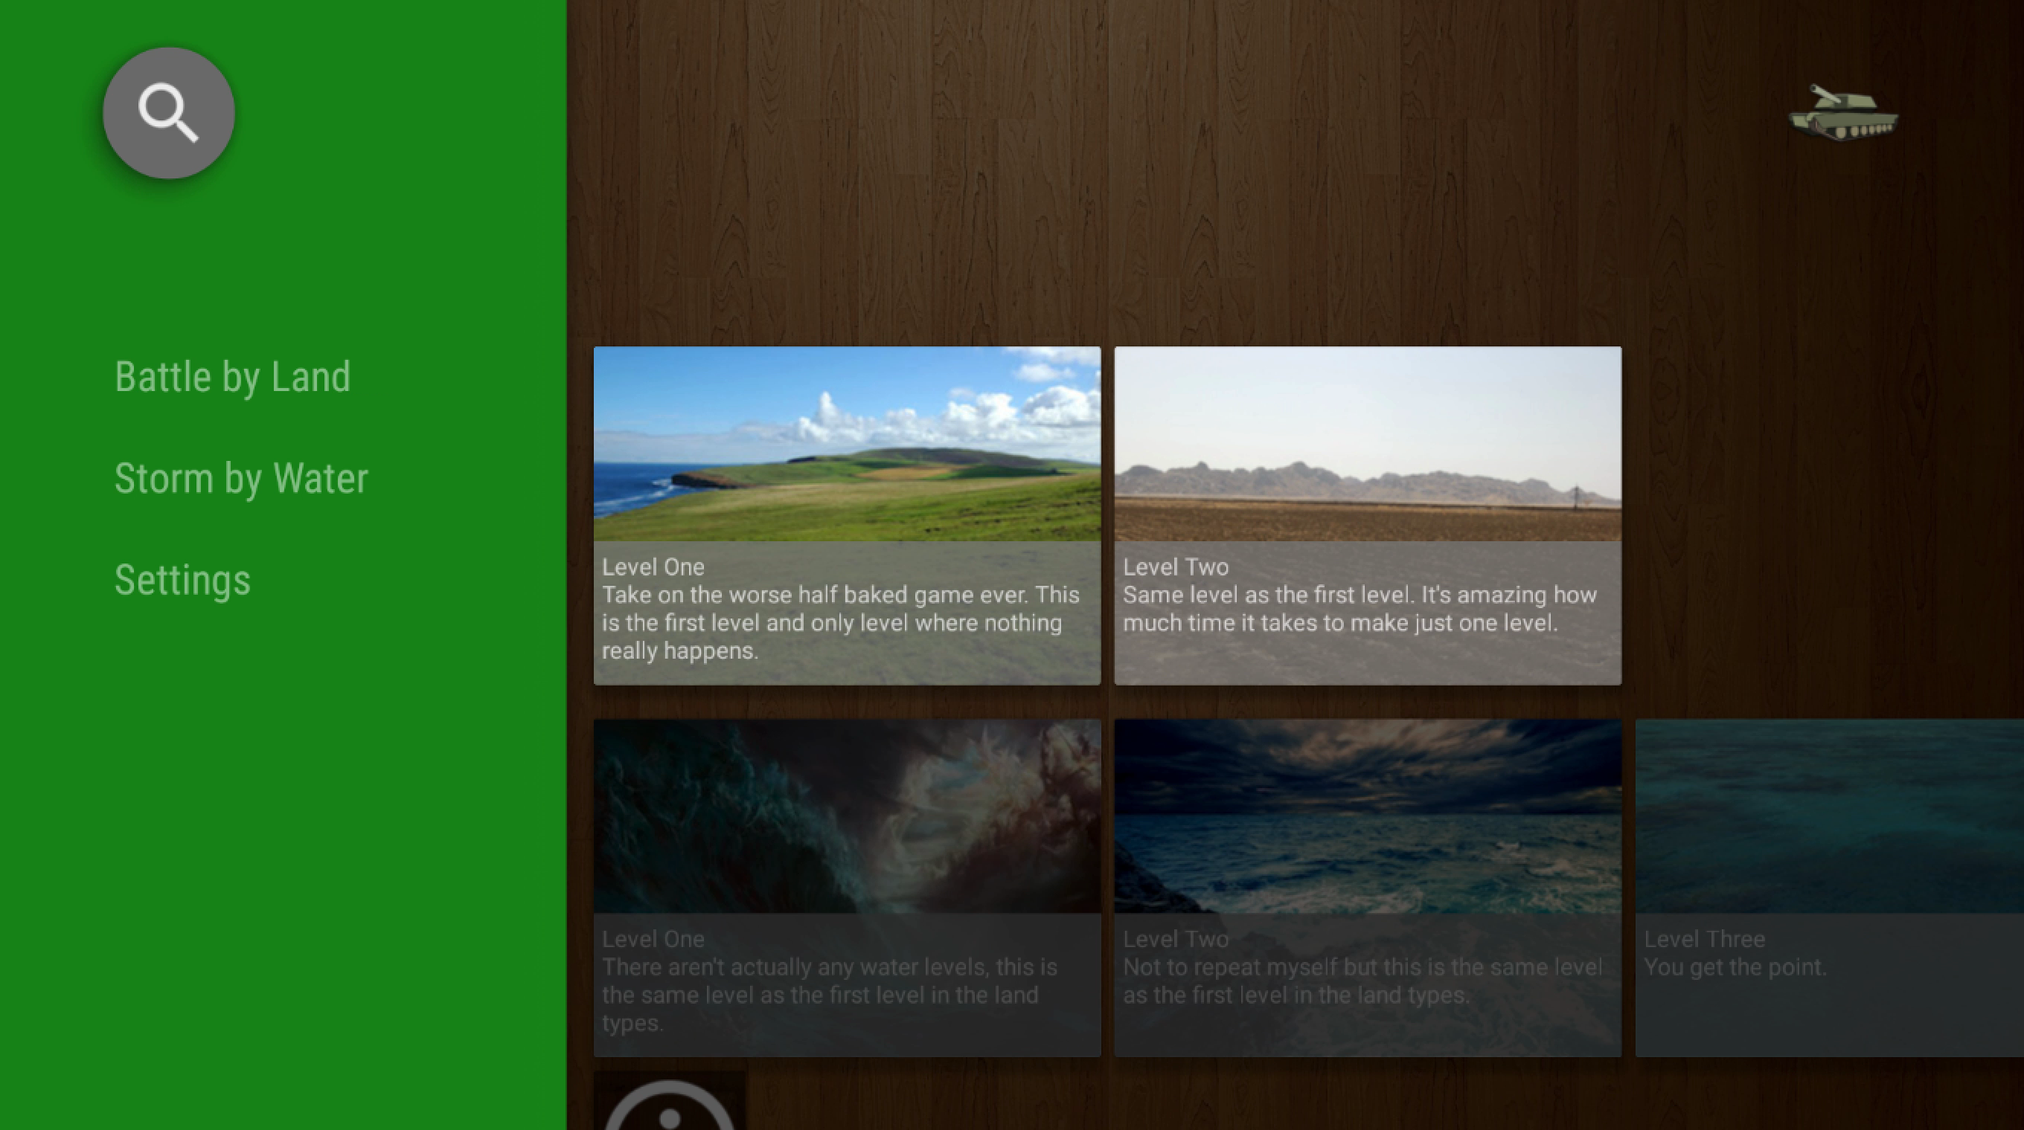
DetailsFragment
Notes:
- Video of details fragment navigation

Slide 24
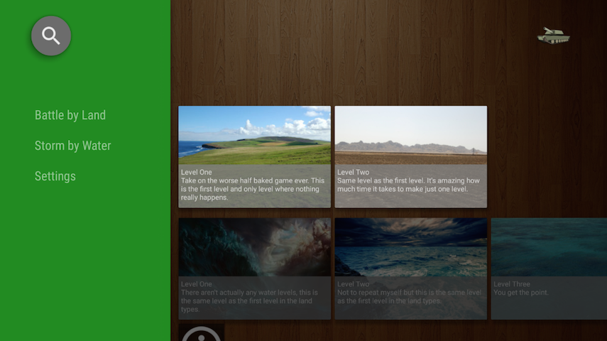
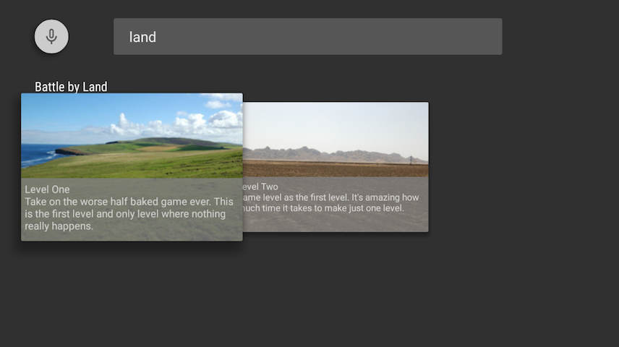
SearchFragment
Notes:
SearchFragment - A fragment to handle searches. The fragment receives the user's search request and passes it to the application-provided SearchResultProvider. The SearchResultProvider returns the search results to theSearchFragment, which renders them into a RowsFragment.

Slide 25
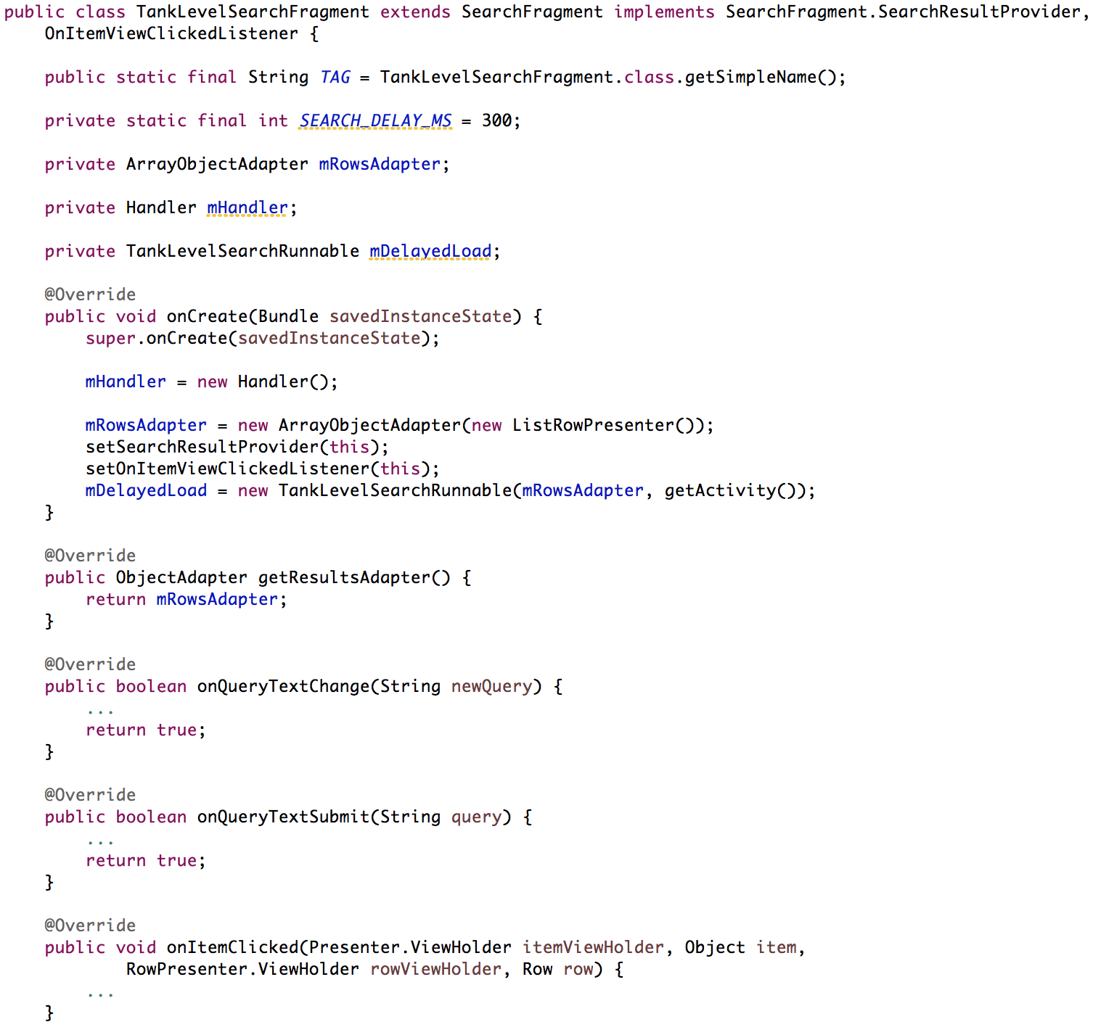
SearchFragment
Extend SearchFragment, Implement SearchResultProvider and OnItemViewClickedListener
Notes:
Extend SearchFragment. There isn’t anything necessary to call except setSearchResultProvider() and setOnItemViewClickedListener() which allow our implemented methods to be the callbacks for the result provider and click listener.

Slide 26
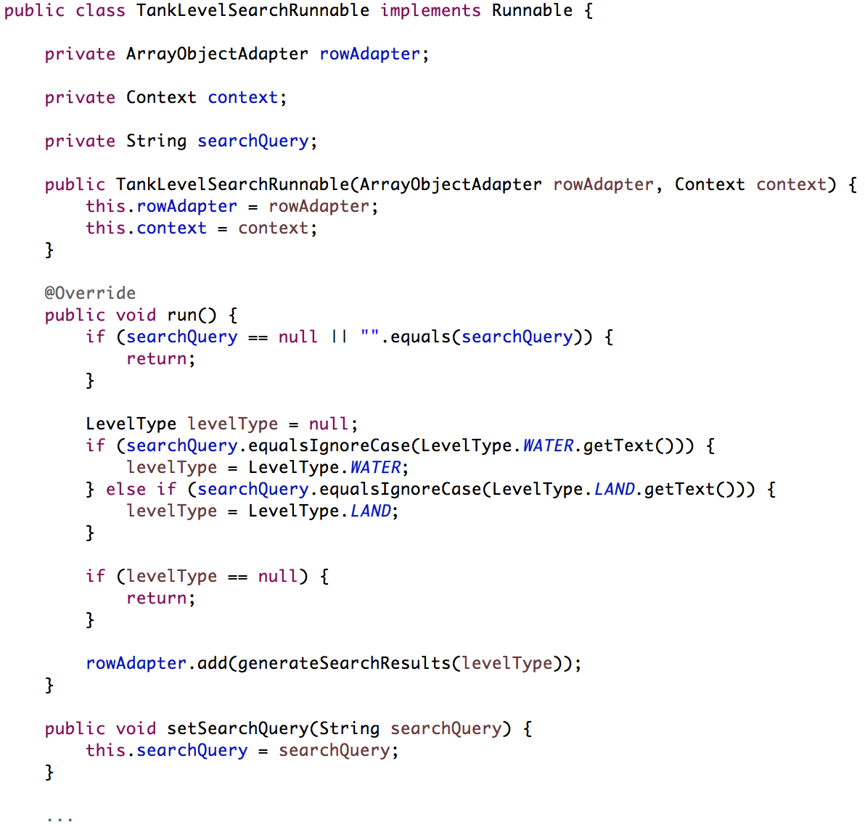
SearchFragment
Create Runnable
Notes:
Create your custom runnable class. This one will take the context and adapter in its constructor. After the query has executed it will update the adapter with the results. Clearing I’m only populating the adapter when the search results are either ‘land’ or ‘water’. You don’t need to do this and infact I would recommend creating your own search logic.

Slide 27
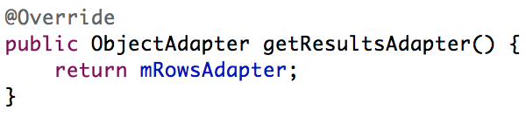
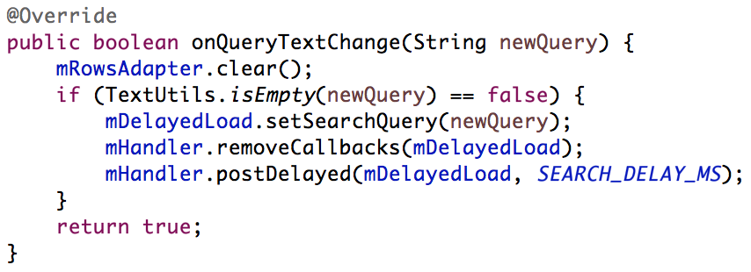
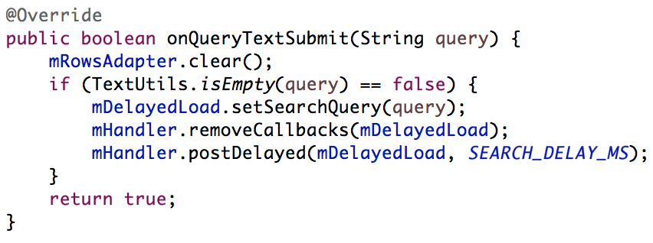
SearchFragment
Implement SearchResultProvider methods
Notes:
Remember mDelayedLoad is an instance of the Runnable shown earlier.
Implement the three methods necessary for SearchResultProvider. They are:
getResultsAdatper(): which should just return the adapter
onQueryTextChange(): which should clear the current adapter, thus clearing the views current search results. If the query is not empty we want to remove any currently executing runnables and start a new one with a timer delay. The timer delay ensures that we don’t keep hitting the server until the user has settled on a query. The time is adjustable, right now I’m using 300ms.
onQueryTextSubmit(): should follow the same logic as onQueryTextChange(). You could remove the timer delay since the user has officially said, hey search this for sure. But for consistency I’ve chosen to leave it in.

Slide 28
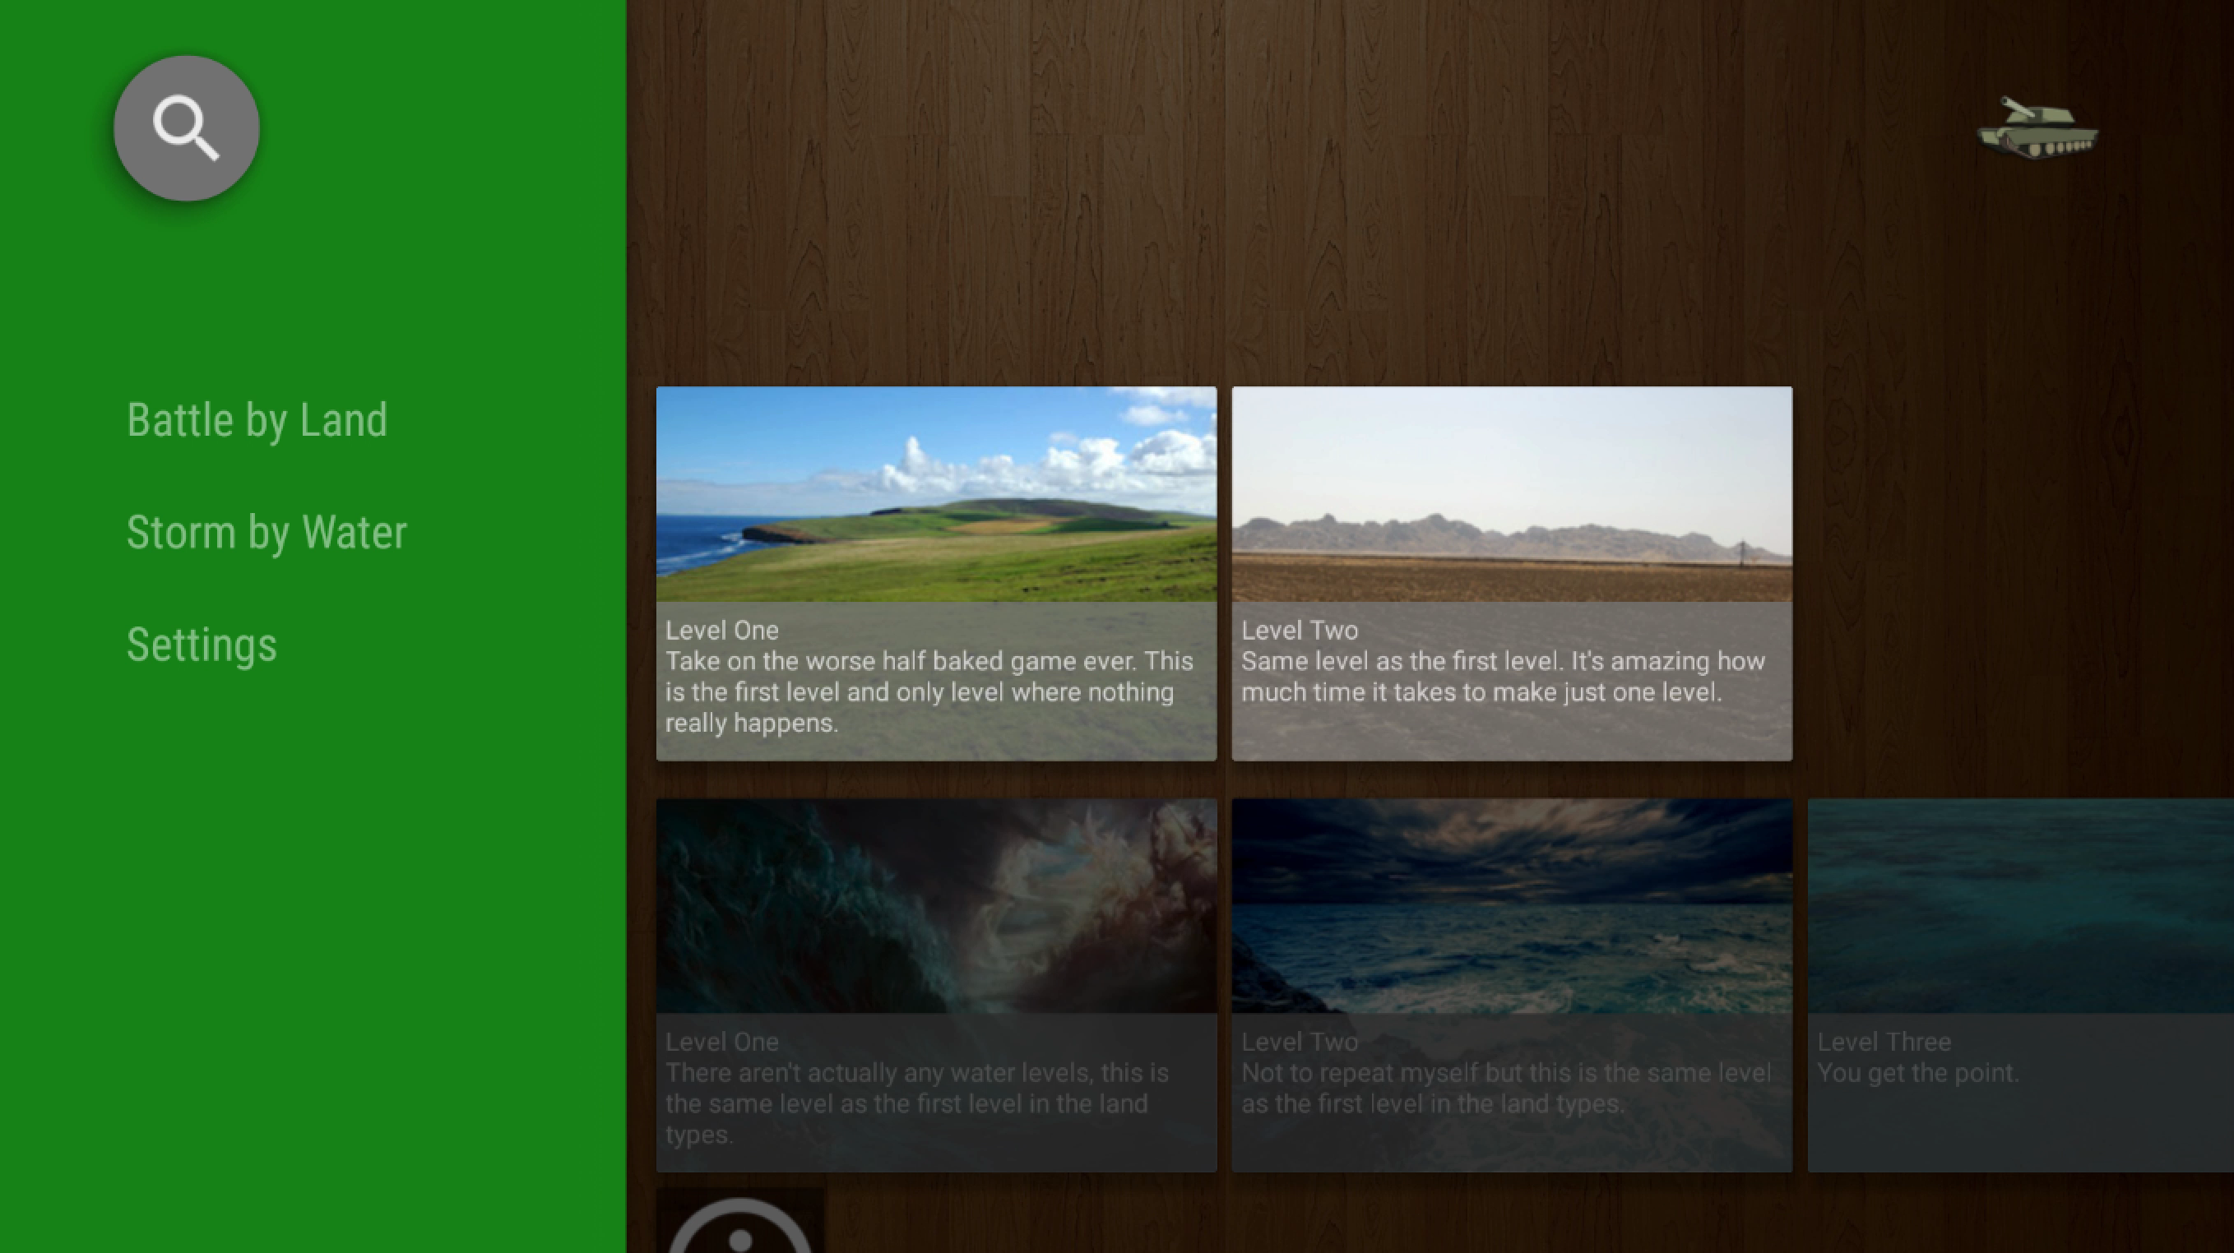
SearchFragment
Notes:
- Video of search fragment navigation

Slide 29
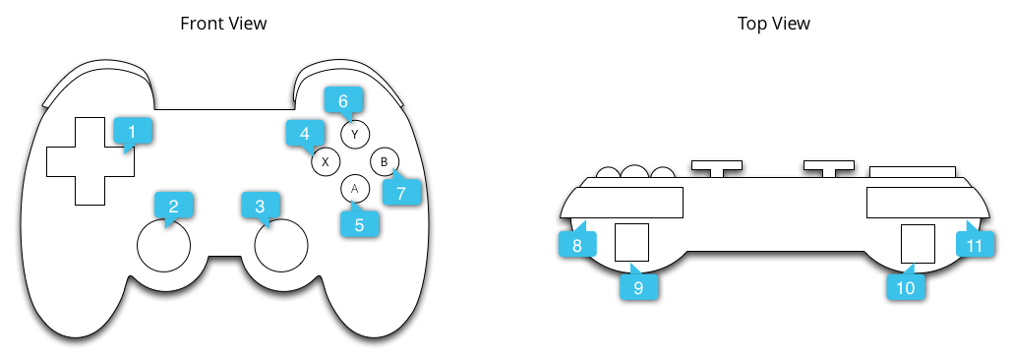
Gamepad
AXIS_HAT_X, AXIS_HAT_Y, DPAD_UP, DPAD_DOWN, DPAD_LEFT, DPAD_RIGHT
AXIS_X, AXIS_Y, BUTTON_THUMBL
AXIS_Z, AXIS_RZ, BUTTON_THUMBR
BUTTON_X
BUTTON_A
BUTTON_Y
BUTTON_B
BUTTON_R1
AXIS_RTRIGGER, AXIS_THROTTLE
AXIS_LTRIGGER, AXIS_BRAKE
BUTTON_L1
Notes:
- This is the generic gamepad controller that’s being sold by Google right now. It’s mappings can be seen below the diagram; these are what we’re going to listen for.

Slide 30
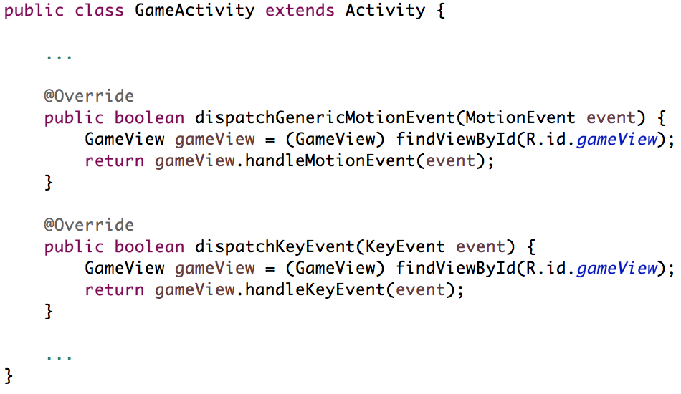
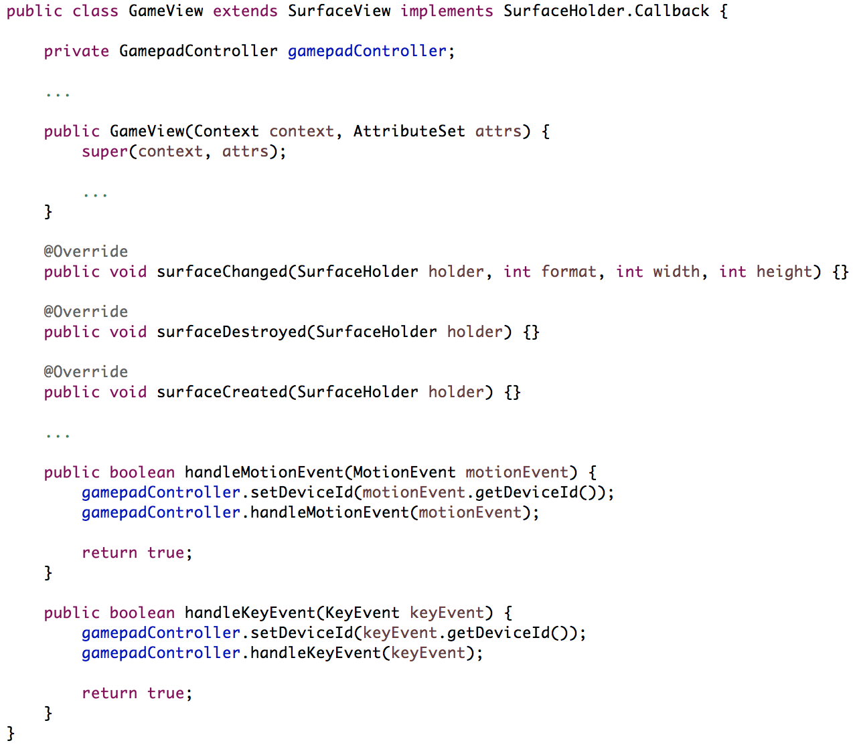
Gamepad
Notes:
- The activity will listen for generic motion events and generic key events. Upon receiving any the activity will pass the event into the GameView which has the instance of the GamepadController.

Slide 31
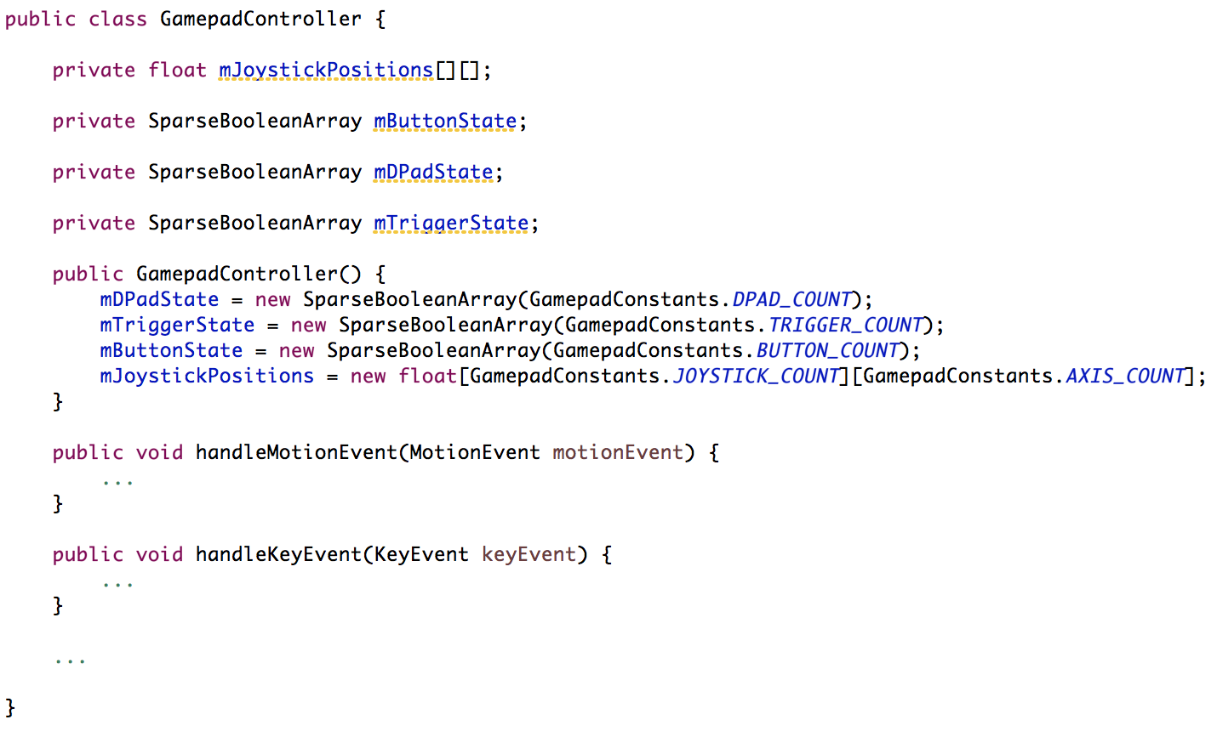
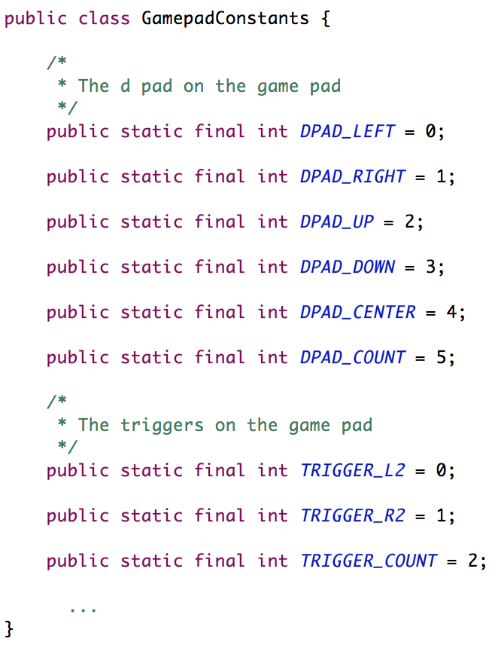
Gamepad
GamepadController
GamepadConstants
Notes:
GamepadController is a helper class to keep track of the button/trigger/joystick states and movements
GamepadConstants contains the static final ‘ids’ used to track the different buttons/triggers/joystick states
Single instance that lives within the GameView and gets passed around to the current level and its objects. These objects will then check the state of the buttons they care about during their update phase.

Slide 32
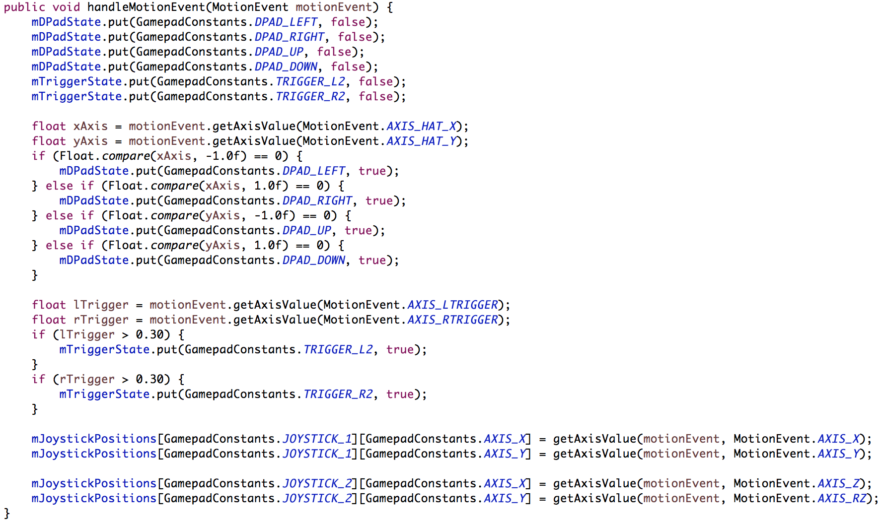
Gamepad
Notes:
This is the handleMotionEvent which handles the gamepad’s right and left triggers, joysticks, and, oddly enough, the DPad.
It is important to note that the joysticks and triggers have degree’s of motion. Obviously the motion event for the joysticks are to map out the new X and Y coordinates, while the degree of motion for the triggers are to map out the pressure in which the user is squeezing the trigger.
I’m not sure why the Dpad slipped through the cracks and is defined as a motion event. There are no degrees of pressing a Dpad button.

Slide 33
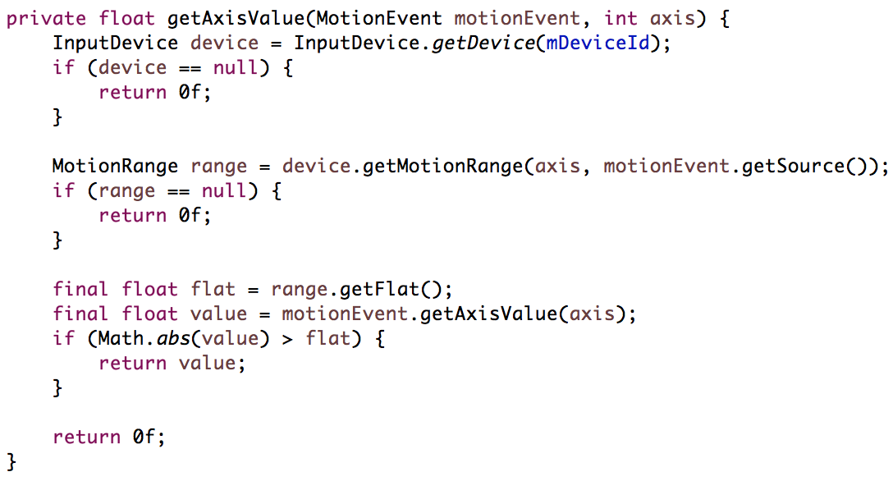
Gamepad
Handling joystick input
Notes:
We need to determine if the joystick is centered, then calculate its axis movements accordingly.
Joysticks typically have a flat area, which is a range of values near the (0,0) coordinate at which the axis is considered to be centered. If the axis value reported by Android falls within the flat area, you should treat the controller to be at rest.

Slide 34
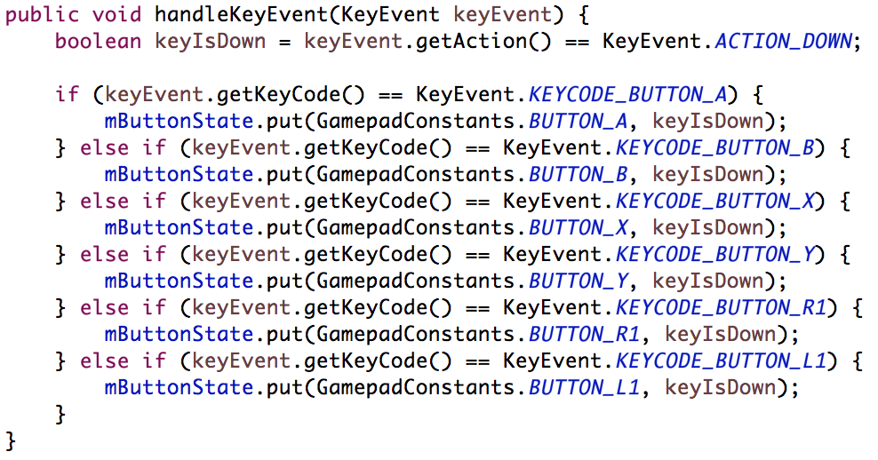
Gamepad
Notes:
This is the handleKeyEvent which handles the gamepad’s buttons, which include the front two bumpers above the triggers.
These button states are either up or down
Note: that this method gets called twice, once when the button is pressed and again when the button is released. Because of this we don’t need to reset the button states as the button state is reset when its released.

Slide 35
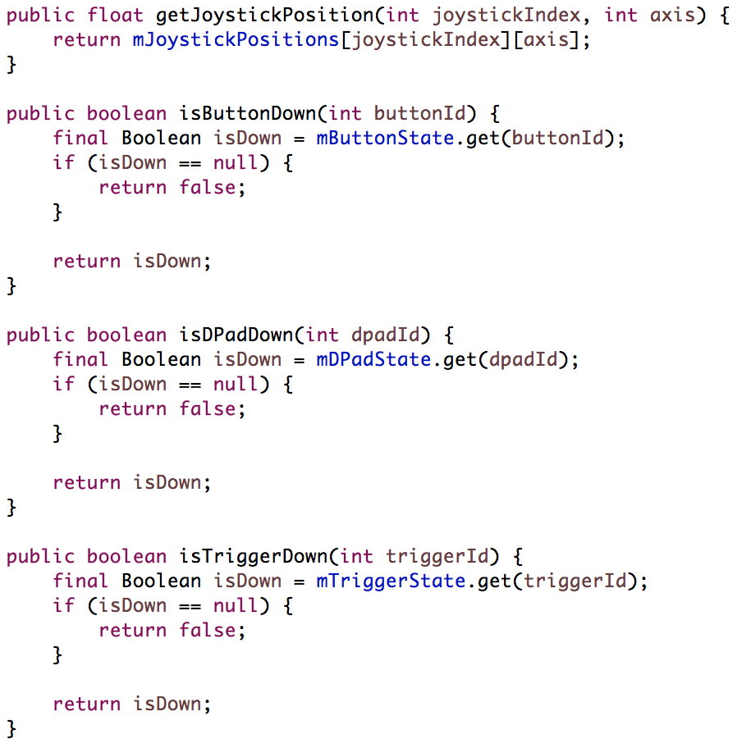
Gamepad
We can check the state of the buttons with these methods.
Notes:
We can now check the state of the buttons using these methods. Within each level or object we will use our instance of the GamepadController, the same one the GameView has, to check button/trigger/joystick states and positions.

Slide 36
Resources
Android TV Design Pattern Guidelines:
https://developer.android.com/design/tv/patterns.html
Android TV Game:
http://www.binpress.com/tutorial/getting-started-with-game-development-for-android-tv/149
Android TV Layout:
http://developer.android.com/tools/support-library/features.html#v17-leanback
https://github.com/malmstein/AndroidTVExplorer

Slide 37
Questions?
Thomas Belk
@yldsmith
github.com/wildsmith/TickTank

